Slide 1

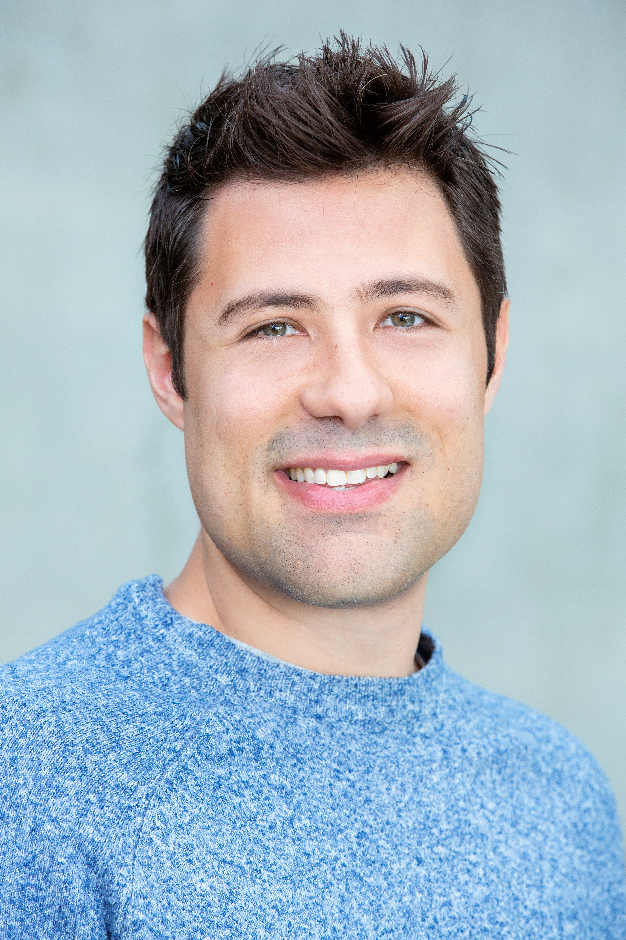



Maurício F. Aniche
Assistant Professor @ TU Delft
M.FinavaroAniche@tudelft.nl
mauricioaniche.com

Slide 2

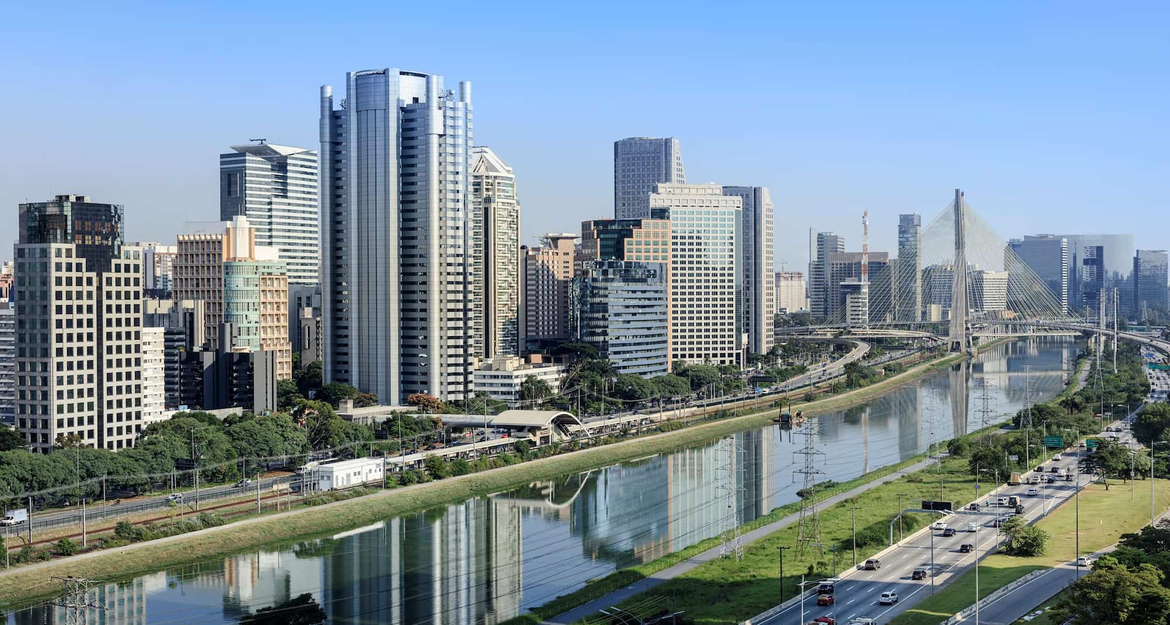
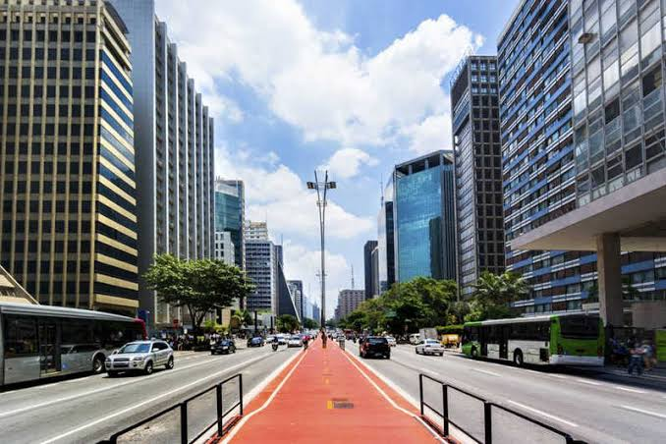
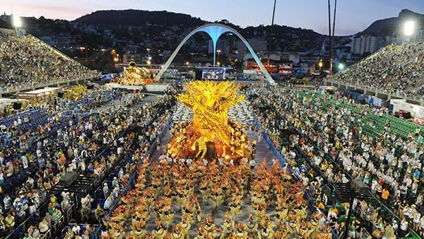

Slide 3

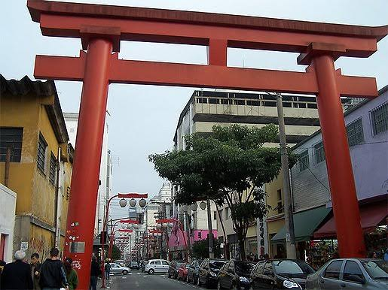
Liberdade (neighborhood in São Paulo)
More than 1 million Japanese people live in São Paulo
(1.8 million in Brazil)
The biggest Japan outside Japan!

Slide 4
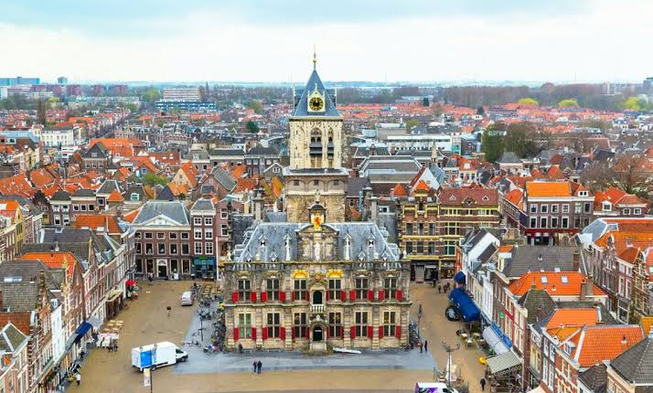



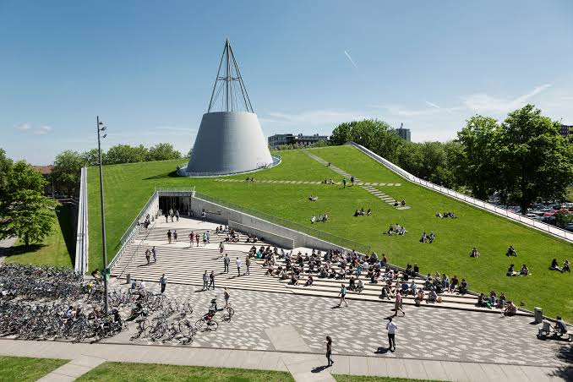

Slide 5
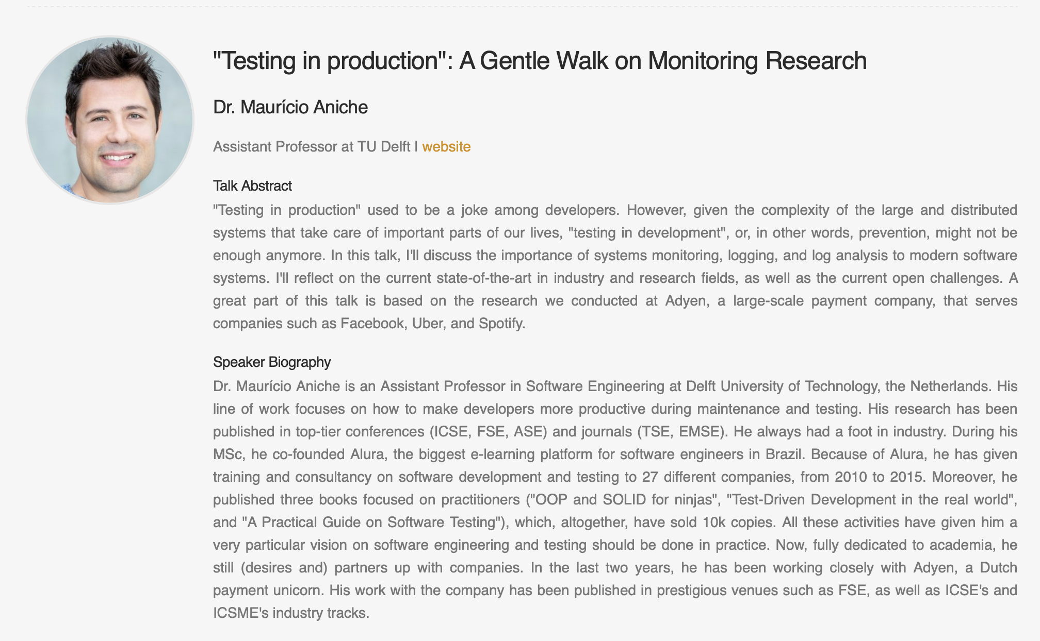
My interests?
Software maintenance and refactoring
Software testing and test code engineering
Runtime monitoring and DevOps
MSR Asia Summit Session!

Slide 6



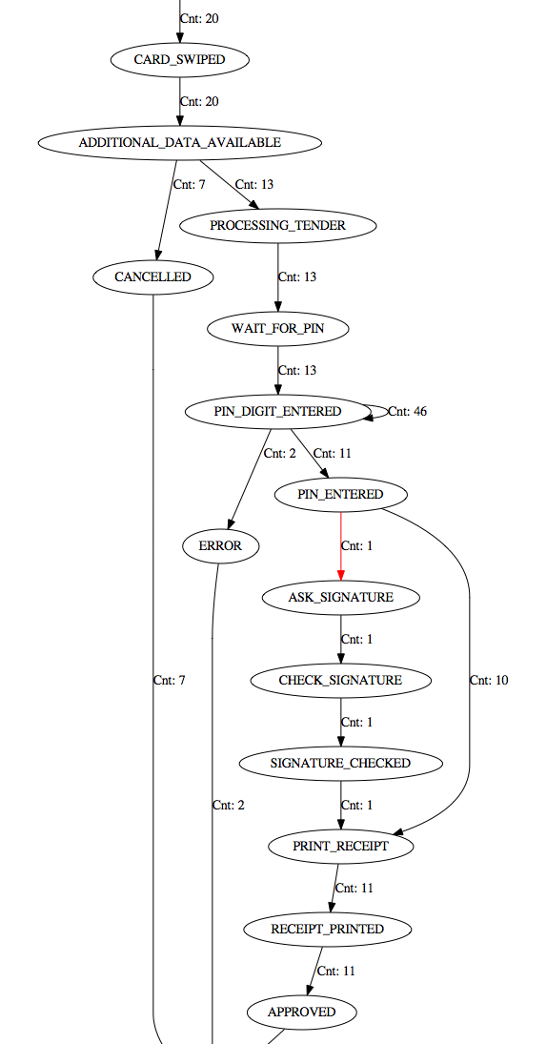

Release Engineering for Mobile Apps
Mobile monitoring / telemetry
Monitoring mobile apps
When, what and where to log?
More specifically, passive learning for mobile apps

